Slide 1
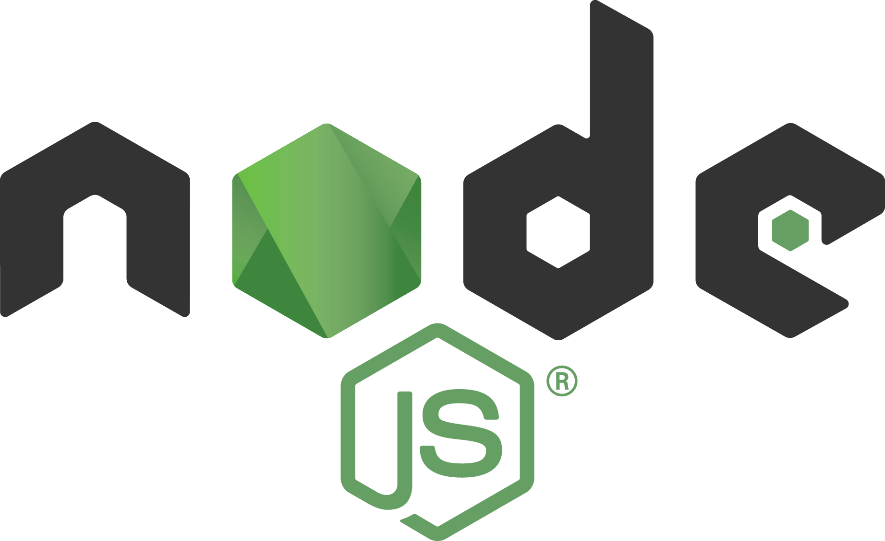

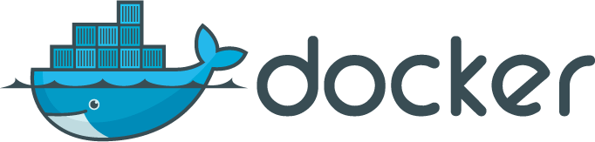
Intermediate Docker: Deploying Applications with Node.js and AWS
1

Slide 2
Module 1: Docker Container Components and Hello, world
2

Slide 3
Containers vs. VMs
3

Slide 4
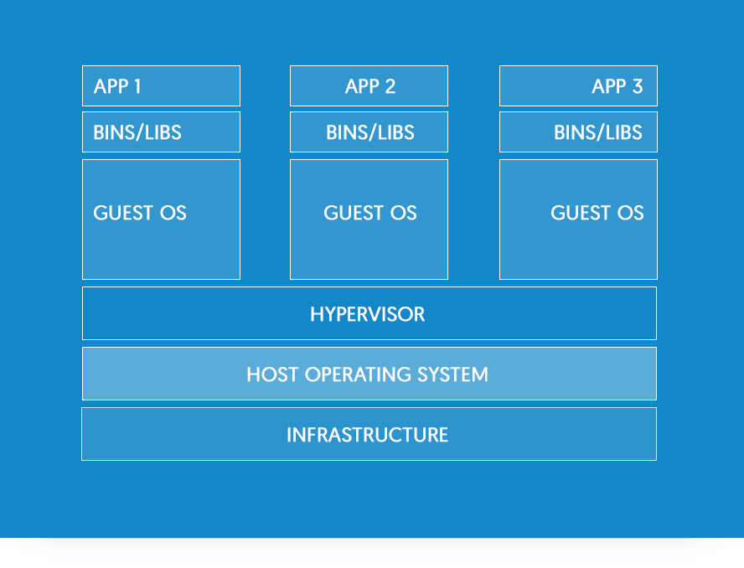
How VMs work
Source: docker.com
4

Slide 5
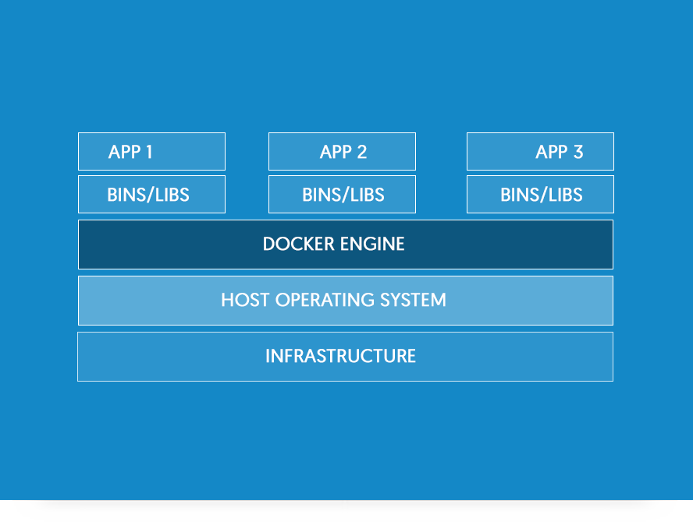
How containers work
Source: docker.com
5

Slide 6
Here are some of the beneﬁts of Docker containers:
•
Allow for rapid application development/deployment
Allow consistent behavior from dev to production, i.e., portable across machines & environments - fewer bugs!
Extendable (reuse, collaboration + community) Lightweight and fast (no guest OS)
Easy to collaborate, use and maintain
Can be versioned and components can be reused
•
•
•
•
•
6

Slide 7
How do containers compare to virtual machines?
“
Containers and virtual machines (VMs) are complementary. VMs excel at providing extreme isolation (for example with hostile tenant applications where you need the ultimate break out prevention).
Containers operate at the process level, which makes them very lightweight and perfect as a unit of software delivery. While VMs take minutes to boot, containers can often be started in less than a second.
”
-Docker.inc
7

Slide 8
Container and Docker Terminology
8

Slide 9
Docker Images
Images – The blueprints of our application which form the basis of containers. We will use the docker pull command to download the speciﬁed image.
9

Slide 10
Docker Containers
Containers – Created from Docker images and run the actual application. We create a container using docker run. A list of running containers can be seen using the docker ps command.
10

Slide 11
Docker Daemon
Docker Daemon – The background service running on the host that manages building, running and distributing Docker containers. The daemon is the process that runs in the operation system to which clients talk to. It is synonmous with the Docker Engine, and does the magic behind the scenes.
10

Slide 12
Docker Client
Docker Client – The command line tool that allows the user to interact with the daemon. There can be other forms of clients – such as Kitematic which provides a GUI.

Slide 13
Docker Hub
Docker Hub – A registry of Docker images. You can think of the registry as a directory of all available Docker images. If required, one can host their own Docker registries and can use them for pulling images.

Slide 14
Dockerﬁle
Dockerﬁle – A recipe from which you can create an image. Dockerﬁle has the base image, instructions to add or copy ﬁles, commands to execute, ports to expose and other information.
Dockerﬁle is case sensitive.

Slide 15
Docker Compose
Docker Compose – A mechanism to orchestrate multiple containers needed for a service(s) from a single conﬁguration ﬁle docker-compose.yml.

Slide 16
Host
Host – Your computer which hosts docker daemon or a remote machine which hosts docker deamon/engine.

Slide 17
Docker workﬂow
Code and create Dockerﬁle
Build an image, tag it, upload to registry (optional)
Run container from an image with env vars, volumes and networks
Re-build and re-run if needed
Stop container

Slide 18
Base Images

Slide 19
Plain OS Base Images:
•
alpine
ubuntu
debian and jessie (debian v8) centos
amazonlinux
•
•
•
•

Slide 20
Environment-Ready Base Images
•
node v7.9 is based on buildpack-deps:jessie
node:alpine v6 is based on alpine
nginx v1.13 is based on debian:stretch-slim Apache httpd v2.2 is based on debian:jessie mongo v3 is based on debian:wheezy-slim postgres v9 is based on debian:jessie
•
•
•
•
•

Slide 21
Dockerﬁle
Dockerﬁle is a blueprint for the images which turn into containers.
20

Slide 22
Main Dockerﬁle statements
•
FROM
RUN WORKDIR COPY EXPOSE CMD
•
•
•
•
•

Slide 23
Dockerﬁle Example
FROM node:6-alpine
RUN mkdir -p /usr/src/app WORKDIR /usr/src/app
COPY server.js /usr/src/app EXPOSE 3000
CMD [ "node", "server.js" ]

Slide 24
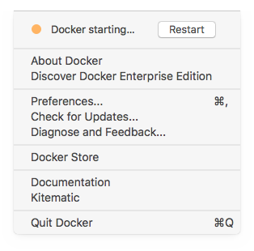
Docker Engine macOS

Slide 25
Creating an Image
Create an image from the current project folder:
docker build .
Create an image with a name and a tag:
docker build -t {your-name}/{your-app-name}:{tag} .

Slide 26
Running Docker Container

Slide 27
docker run
Example of running Alpine and executing echo in it:
docker run alpine echo "hello from alpine"
For usage and all ﬂags/options:
docker run --help

Slide 28
Some useful options to the docker run command are:
•
-d will detach our terminal (bg/daemon).
-rm will remove the container after running.
-it attaches an interactive tty (teletype) in the container.
-p will publish/expose ports for our container.
--name a name for our container.
-v mounts a volume to share between host and container.
-e provides environment vars to the container.
•
•
•
•
•
•

Slide 29
Alpine Hello World
Run Alpine and execute echo in it (just one command):
docker run alpine echo "hello from alpine"
Result: hello from alpine

Slide 30
Ubuntu tty
Run Ubuntu and use tty in the container with the –it ﬂag:
docker run -it ubuntu
Poke around with pwd and cd.

Slide 31
Dockerﬁle Hello World example
Project folder structure:
/docker-node-hello Dockerfile server.js
30

Slide 32
Main app ﬁle
server.js:
const port = 3000 require('http')
.createServer((req, res) => { console.log('url:', req.url) res.end('hello world')
})
.listen(port, (error)=>{
console.log(`server is running on ${port}`)
})

Slide 33
Hello World Dockerﬁle
Dockerﬁle:
FROM node:6-alpine
RUN mkdir -p /usr/src/app WORKDIR /usr/src/app
COPY server.js /usr/src/app EXPOSE 3000
CMD [ "node", "server.js" ]

Slide 34
Build the image:
docker build .

Slide 35
docker build .
Sending build context to Docker daemon 3.072 kB Step 1/6 : FROM node:6-alpine
6-alpine: Pulling from library/node 709515475419: Pull complete cb714116d354: Pull complete 25b12811305e: Pull complete
Digest: sha256:823cf041070ca762608a3a5b4c8ee620df093b2e86c6def04d40d0e5acfe3467 Status: Downloaded newer image for node:6-alpine
---> 24d2680547f5
Step 2/6 : RUN mkdir -p /usr/src/app
---> Running in 8b52d4f59a57
---> 20f588f821c8
Removing intermediate container 8b52d4f59a57 Step 3/6 : WORKDIR /usr/src/app
---> 33998dd83654
Removing intermediate container cbf35b20a2a2 Step 4/6 : COPY server.js /usr/src/app
---> bc832e3172dd
Removing intermediate container 0529df33ca82 Step 5/6 : EXPOSE 3000
---> Running in e32c6f35d1b1
---> ead36d9c8800
Removing intermediate container e32c6f35d1b1 Step 6/6 : CMD node server.js
---> Running in a4b3a0eeeaef
---> a1888c63ecfb
Removing intermediate container a4b3a0eeeaef Successfully built a1888c63ecfb

Slide 36
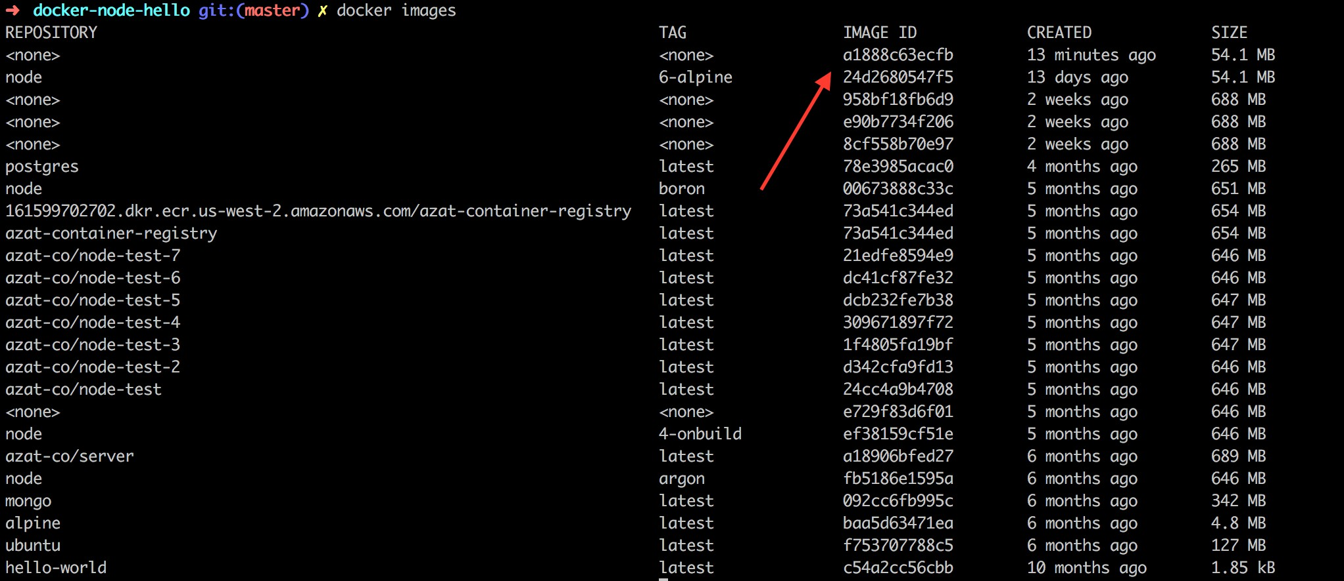
Verify and copy newly built image ID:
docker images

Slide 37
Run with mapping ports host:container:
docker run -p 80:3000 {image-id}
For example:
docker run -p 80:3000 a1888c63ecfb
Output (from container):
server is running on 3000

Slide 38
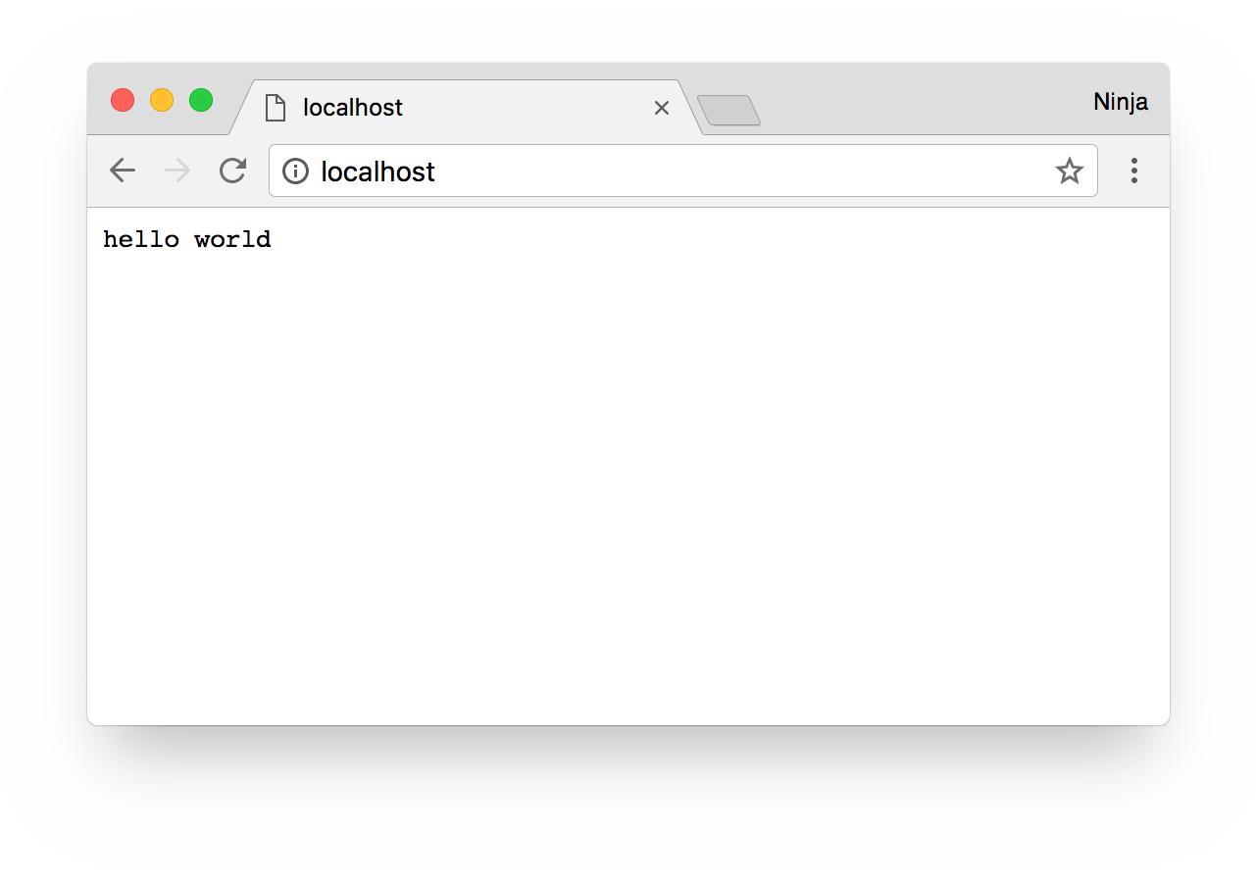
Verify "Hello world" in new terminal session.
curl http://localhost
or in the browser: http://localhost
Remember port 80 is the default port value for HTTP so no need to type it in the URL.

Slide 39
Also, verify with Docker Engine:
docker ps
Output example:
CONTAINER ID | IMAGE | COMMAND | CREATED | STATUS | PORTS | NAMES
9e8fad455bff | a1888c63ecfb | "node server.js" | 2 minutes ago | Up 2 minutes | 0.0.0.0:80->3000/tcp | quizzical_ardinghelli

Slide 40
Stop:
docker stop {image-id}
For example:
docker stop 19b4df5a399c

Slide 41
Congrats! You have run your first Node.js web server inside of a container.
40

